Slide 1
A Comparison of Two Scriptures…Main Points
1
1 Kings Chapter 1
King David is old and dying
They find Abishag to keep him warm
Adonijah (David’s son) tries to take the throne
Bathsheba begs David to make her son, Solomon, king
David makes Solomon king
…and…
The Book of Esther
The king of Persia rejects Queen Vashti
Esther (a Jew) becomes queen
Mordecai her cousin advises her
Wicked Haman plots to kill the Jews
Esther petitions the king
The king allows Jews to be saved

Slide 2
2
1 Kings Chapter 1
King David is
old, cold
and dying.

Slide 3
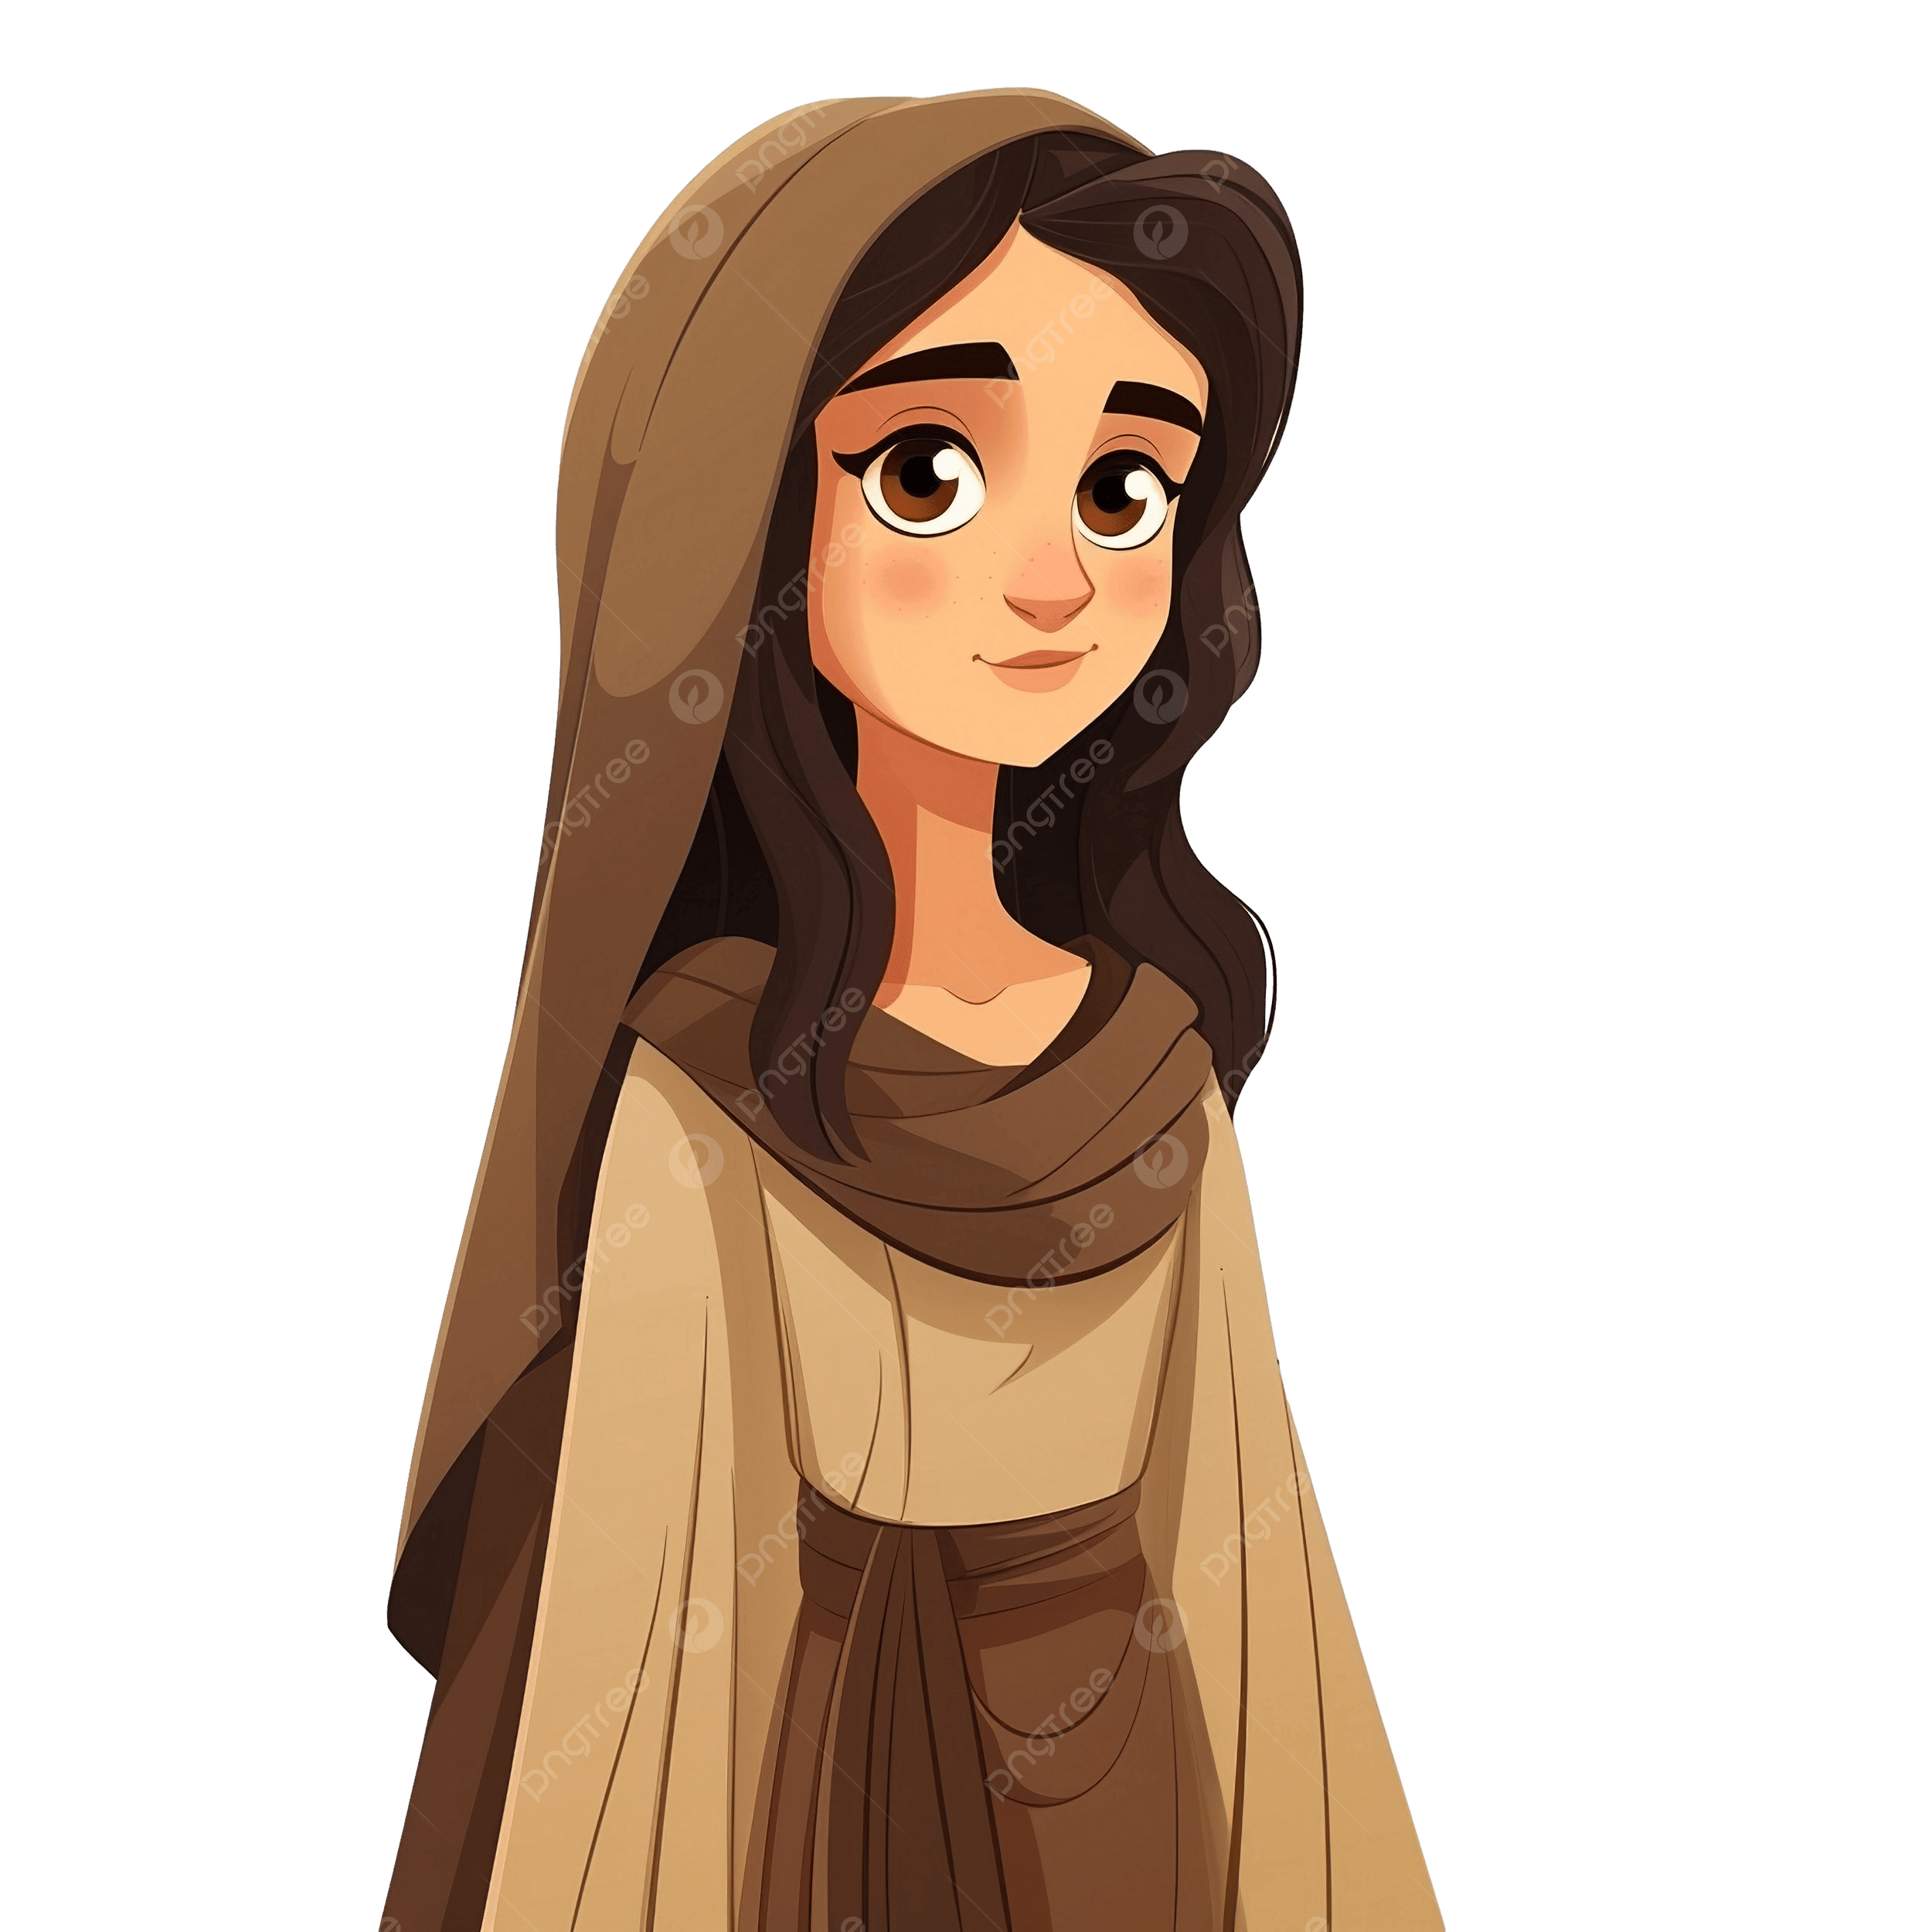
3
1 Kings Chapter 1
They search throughout the kingdom for a virgin
to keep him warm = Abishag
King David is
old, cold
and dying.

Slide 4
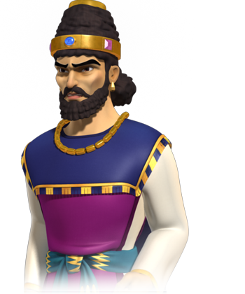
4
1 Kings Chapter 1
Adonijah
(David’s son) tries to make himself king,
unbeknown to David
They search throughout the kingdom for a virgin
to keep him warm = Abishag
King David is
old, cold
and dying.

Slide 5
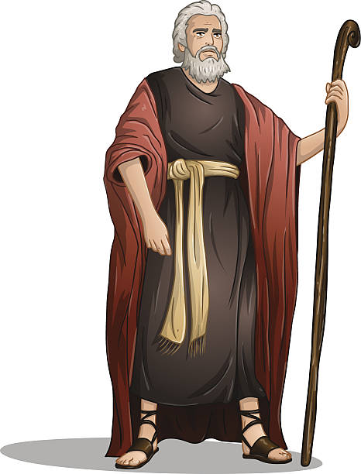
5
1 Kings Chapter 1
Adonijah
(David’s son) tries to make himself king,
unbeknown to David
They search throughout the kingdom for a virgin
to keep him warm = Abishag
Nathan the prophet sees what Adonijah has done…
King David is
old, cold
and dying.

Slide 6
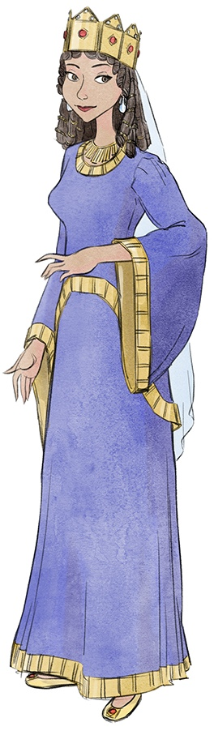
6
1 Kings Chapter 1
Adonijah
(David’s son) tries to make himself king,
unbeknown to David
They search throughout the kingdom for a virgin
to keep him warm = Abishag
Nathan the prophet sees what Adonijah has done…
…and tells David’s wife Bathsheba to urge the king to make Solomon king quickly!
King David is
old, cold
and dying.
Bathsheba
(David’s wife)

Slide 7
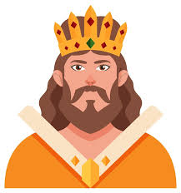

7
1 Kings Chapter 1
Adonijah
(David’s son) tries to make himself king,
unbeknown to David
They search throughout the kingdom for a virgin
to keep him warm = Abishag
Solomon
(David and
Bathsheba’s
Son)
Nathan the prophet sees what Adonijah has done…
…and tells David’s wife Bathsheba to urge the king to make Solomon king quickly!
King David is
old, cold
and dying.
Bathsheba
(David’s wife)

Slide 8
8
1 Kings Chapter 1
Adonijah
(David’s son) tries to make himself king,
unbeknown to David
They search throughout the kingdom for a virgin
to keep him warm = Abishag
Bathsheba reminds the king that her son Solomon will be king after him…
Nathan the prophet sees what Adonijah has done…
…and tells David’s wife Bathsheba to urge the king to make Solomon king quickly!
King David is
old, cold
and dying.

Slide 9
9
1 Kings Chapter 1
Adonijah
(David’s son) tries to make himself king,
unbeknown to David
They search throughout the kingdom for a virgin
to keep him warm = Abishag
Bathsheba reminds the king that her son Solomon will be king after him…
Nathan the prophet sees what Adonijah has done…
…and tells David’s wife Bathsheba to urge the king to make Solomon king quickly!
King David is
old, cold
and dying.
…David agrees and makes Solomon king

Slide 10
10
1 Kings Chapter 1
(The palace)
Adonijah
(David’s son) tries to make himself king,
unbeknown to David
They search throughout the kingdom for a virgin
to keep him warm = Abishag
Bathsheba reminds the king that her son Solomon will be king after him…
Nathan the prophet sees what Adonijah has done…
…and tells David’s wife Bathsheba to urge the king to make Solomon king quickly!
King David is
old, cold
and dying.
…David agrees and makes Solomon king

Slide 11

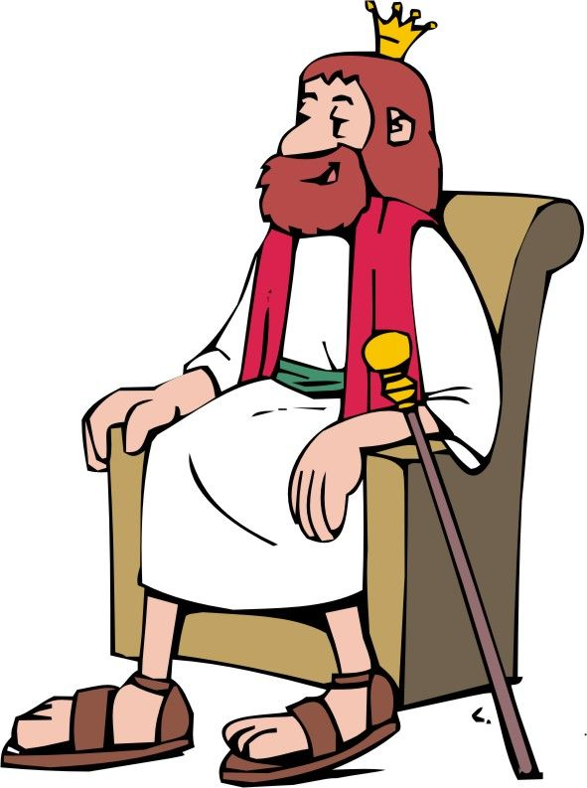
11
Book of Esther
Beautiful
Queen Vashti
King of Persia

Slide 12
12
Book of Esther
Beautiful
Queen Vashti
Vashti disobeys the king and is removed
King of Persia

Slide 13
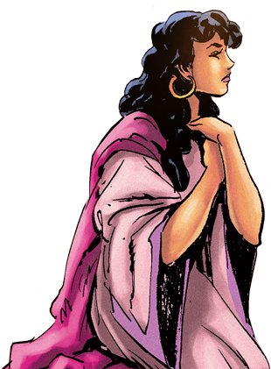
13
Book of Esther
They search for a new queen and Esther,
(a Jew),
is chosen
King of Persia

Slide 14
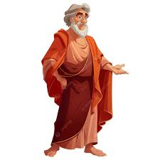
14
Book of Esther
They search for a new queen and Esther,
(a Jew),
is chosen
Mordecai, (a Jew) and Esther’s cousin and guardian advises her from outside the palace
King of Persia

Slide 15
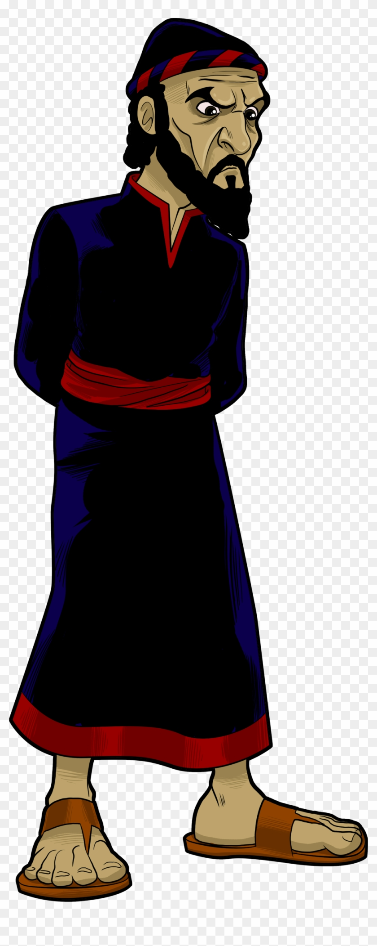
15
Book of Esther
The king promotes wicked Haman who hates Mordecai and seeks to destroy
the Jews
They search for a new queen and Esther,
(a Jew),
is chosen
Mordecai, (a Jew) and Esther’s cousin and guardian advises her from outside the palace
King of Persia

Slide 16
16
Book of Esther
The king promotes wicked Haman who hates Mordecai and seeks to destroy
the Jews
They search for a new queen and Esther,
(a Jew),
is chosen
Mordecai, (a Jew) and Esther’s cousin and guardian advises her from outside the palace
Mordecai urges Esther to petition the king to save the Jews
King of Persia

Slide 17
17
Book of Esther
Esther bravely goes before the king and (after two banquets) asks the king to save the Jews. The king allows the Jews to fight back…
The king promotes wicked Haman who hates Mordecai and seeks to destroy
the Jews
They search for a new queen and Esther,
(a Jew),
is chosen
Mordecai, (a Jew) and Esther’s cousin and guardian advises her from outside the palace
Mordecai urges Esther to petition the king to save the Jews
King of Persia

Slide 18
18
Book of Esther
Esther bravely goes before the king and (after two banquets) asks the king to save the Jews. The king allows the Jews to fight back…
The king promotes wicked Haman who hates Mordecai and seeks to destroy
the Jews
…Haman is found to have tried to destroy the Jews and is hung on the gallows he built for Mordecai..!
They search for a new queen and Esther,
(a Jew),
is chosen
Mordecai, (a Jew) and Esther’s cousin and guardian advises her from outside the palace
Mordecai urges Esther to petition the king to save the Jews
King of Persia

Slide 19
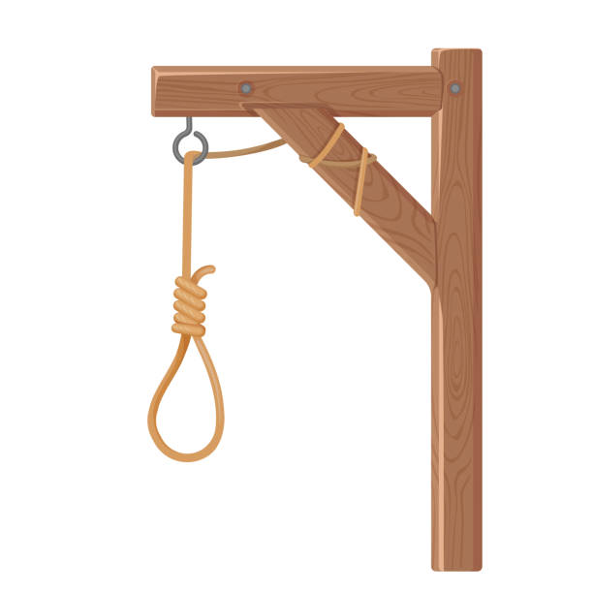
19
Book of Esther
Esther bravely goes before the king and (after two banquets) asks the king to save the Jews. The king allows the Jews to fight back…
The king promotes wicked Haman who hates Mordecai and seeks to destroy
the Jews
…Haman is found to have tried to destroy the Jews and is hung on the gallows he built for Mordecai..!
They search for a new queen and Esther,
(a Jew),
is chosen
Mordecai, (a Jew) and Esther’s cousin and guardian advises her from outside the palace
Mordecai urges Esther to petition the king to save the Jews
King of Persia

Slide 20
20
Book of Esther
(The palace)
Esther bravely goes before the king and (after two banquets) asks the king to save the Jews. The king allows the Jews to fight back…
The king promotes wicked Haman who hates Mordecai and seeks to destroy
the Jews
…Haman is found to have tried to destroy the Jews and is hung on the gallows he built for Mordecai..!
They search for a new queen and Esther,
(a Jew),
is chosen
Mordecai, (a Jew) and Esther’s cousin and guardian advises her from outside the palace
Mordecai urges Esther to petition the king to save the Jews
King of Persia

Slide 21
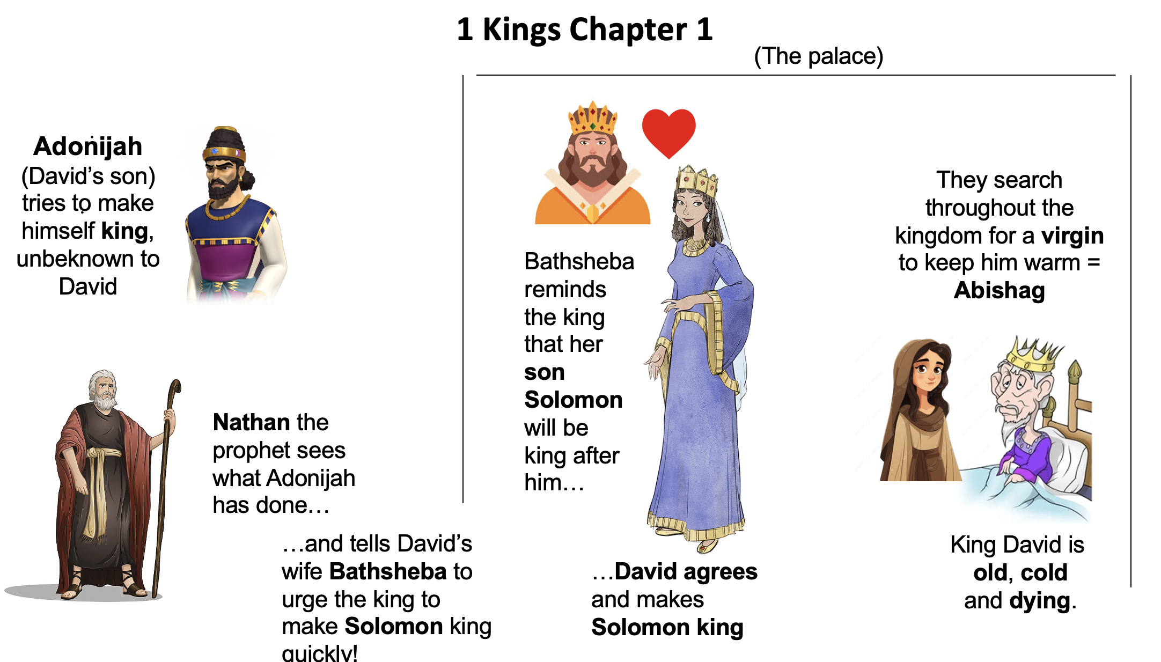
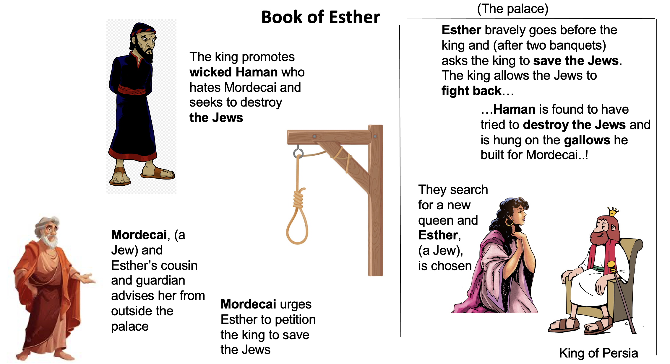
21

Slide 22
22
Similarities between the two stories. (1 Kings Chapter 1 / Book of Esther)
The king requires a wife/virgin ………..(David is old and cold / King Persia removes Vashti)

Slide 23
23
Similarities between the two stories. (1 Kings Chapter 1 / Book of Esther)
The king requires a wife/virgin ………..(David is old and cold / King Persia removes Vashti)
Servants search for a wife/virgin……….. (Abishag is chosen for David / Esther is chosen for King Persia)

Slide 24
24
Similarities between the two stories. (1 Kings Chapter 1 / Book of Esther)
The king requires a wife/virgin ………..(David is old and cold / King Persia removes Vashti)
Servants search for a wife/virgin……….. (Abishag is chosen for David / Esther is chosen for King Persia)
There’s a threat to the wife’s family……….. (Adonijah wants throne from Solomon / Haman wants to kill the Jews)

Slide 25
25
Similarities between the two stories. (1 Kings Chapter 1 / Book of Esther)
The king requires a wife/virgin ………..(David is old and cold / King Persia removes Vashti)
Servants search for a wife/virgin……….. (Abishag is chosen for David / Esther is chosen for King Persia)
There’s a threat to the wife’s family ………. (Adonijah wants throne from Solomon / Haman wants to kill the Jews)
The king is unaware of the threat……….. (David is old / King Persia is unaware)

Slide 26
26
Similarities between the two stories. (1 Kings Chapter 1 / Book of Esther)
The king requires a wife/virgin ………..(David is old and cold / King Persia removes Vashti)
Servants search for a wife/virgin……….. (Abishag is chosen for David / Esther is chosen for King Persia
There’s a threat to the wife’s family ………. (Adonijah wants throne from Solomon / Haman wants to kill the Jews)
The king is unaware of the threat……….. (David is old / King Persia is unaware)
Both Nathan and Mordecai, outside of the palace, hear of the threat.

Slide 27
27
Similarities between the two stories. (1 Kings Chapter 1 / Book of Esther)
The king requires a wife/virgin ………..(David is old and cold / King Persia removes Vashti)
Servants search for a wife/virgin……….. (Abishag is chosen for David / Esther is chosen for King Persia
There’s a threat to the wife’s family ………. (Adonijah wants throne from Solomon / Haman wants to kill the Jews)
The king is unaware of the threat……….. (David is old / King Persia is unaware)
Both Nathan and Mordecai, outside of the palace, hear of the threat.
They speak to the king’s wife……….. (Nathan speaks to Bathsheba / Mordecai speaks to Esther.)

Slide 28
28
Similarities between the two stories. (1 Kings Chapter 1 / Book of Esther)
The king requires a wife/virgin ………..(David is old and cold / King Persia removes Vashti)
Servants search for a wife/virgin……….. (Abishag is chosen for David / Esther is chosen for King Persia
There’s a threat to the wife’s family ………..(Adonijah wants throne from Solomon / Haman wants to kill the Jews)
The king is unaware of the threat……….. (David is old / King Persia is unaware)
Both Nathan and Mordecai, outside of the palace, hear of the threat.
They speak to the king’s wife……….. (Nathan speaks to Bathsheba / Mordecai speaks to Esther.)
They tell the wife ‘Go to the king – urge him to act!’ ………..(Nathan tells Bathsheba / Mordecai tells Esther.)

Slide 29
29
Similarities between the two stories. (1 Kings Chapter 1 / Book of Esther)
The king requires a wife/virgin ………..(David is old and cold / King Persia removes Vashti)
Servants search for a wife/virgin……….. (Abishag is chosen for David / Esther is chosen for King Persia
There’s a threat to the wife’s family ………..(Adonijah wants throne from Solomon / Haman wants to kill the Jews)
The king is unaware of the threat……….. (David is old / King Persia is unaware)
Both Nathan and Mordecai, outside of the palace, hear of the threat.
They speak to the king’s wife……….. (Nathan speaks to Bathsheba / Mordecai speaks to Esther.)
They tell the wife ‘Go to the king – urge him to act!’ ………..(Nathan tells Bathsheba / Mordecai tells Esther.)
Wife goes to the king ‘Save my son / my people’ ………..(Bathsheba asks for Solomon / Esther asks for the Jews.)

Slide 30
30
Similarities between the two stories. (1 Kings Chapter 1 / Book of Esther)
The king requires a wife/virgin ………..(David is old and cold / King Persia removes Vashti)
Servants search for a wife/virgin……….. (Abishag is chosen for David / Esther is chosen for King Persia
There’s a threat to the wife’s family ………. (Adonijah wants throne from Solomon / Haman wants to kill the Jews)
The king is unaware of the threat……….. (David is old / King Persia is unaware)
Both Nathan and Mordecai, outside of the palace, hear of the threat.
They speak to the king’s wife……….. (Nathan speaks to Bathsheba / Mordecai speaks to Esther.)
They tell the wife ‘Go to the king – urge him to act!’ ………..(Nathan tells Bathsheba / Mordecai tells Esther.)
Wife goes to the king ‘Save my son / my people’ ………..(Bathsheba asks for Solomon / Esther asks for the Jews.)
The king acts after being petitioned…..…(David says ‘Solomon WILL be king!’ / King Persia ‘Jews CAN fight back!’)

Slide 31
31
Similarities between the two stories. (1 Kings Chapter 1 / Book of Esther)
The king requires a wife/virgin ………..(David is old and cold / King Persia removes Vashti)
Servants search for a wife/virgin……….. (Abishag is chosen for David / Esther is chosen for King Persia
There’s a threat to the wife’s family ………. (Adonijah wants throne from Solomon / Haman wants to kill the Jews)
The king is unaware of the threat……….. (David is old / King Persia is unaware)
Both Nathan and Mordecai, outside of the palace, hear of the threat.
They speak to the king’s wife……….. (Nathan speaks to Bathsheba / Mordecai speaks to Esther.)
They tell the wife ‘Go to the king – urge him to act!’ ………..(Nathan tells Bathsheba / Mordecai tells Esther.)
Wife goes to the king ‘Save my son / my people’ ………..(Bathsheba asks for Solomon / Esther asks for the Jews.)
The king acts after being petitioned…..…(David says ‘Solomon WILL be king!’ / King Persia ‘Jews CAN fight back!’)
The enemy is defeated / killed on orders from the king……….. (Adonijah killed / Haman hung)

Slide 32
32
Similarities between the two stories. (1 Kings Chapter 1 / Book of Esther)
The king requires a wife/virgin ………..(David is old and cold / King Persia removes Vashti)
Servants search for a wife/virgin……….. (Abishag is chosen for David / Esther is chosen for King Persia
There’s a threat to the wife’s family ………..(Adonijah wants throne from Solomon / Haman wants to kill the Jews)
The king is unaware of the threat……….. (David is old / King Persia is unaware)
Both Nathan and Mordecai, outside of the palace, hear of the threat.
They speak to the king’s wife……….. (Nathan speaks to Bathsheba / Mordecai speaks to Esther.)
They tell the wife ‘Go to the king – urge him to act!’ ………..(Nathan tells Bathsheba / Mordecai tells Esther.)
Wife goes to the king ‘Save my son / my people’ ………..(Bathsheba asks for Solomon / Esther asks for the Jews.)
The king acts after being petitioned…..…(David says ‘Solomon WILL be king!’ / King Persia ‘Jews CAN fight back!’)
The enemy is defeated / killed on orders from the king……….. (Adonijah killed / Haman hung)
The wife’s son / people prosper ……….. (Solomon becomes wise king / The Jews are blessed in Persia)

Slide 33
…but what does it mean?
33

Slide 34
34
Meaning / interpretation
The king requires a wife/virgin………God desires fellowship / warmth from the Church / The Bride of Christ.

Slide 35
35
Meaning / interpretation
The king requires a wife/virgin………God desires fellowship / warmth from the Church / The Bride of Christ.
They search for /choose a wife/virgin ……… As believers, we are called and chosen by God
1 Peter 2v9 ‘But you are a chosen people, a royal priesthood, a holy nation, God’s special possession’.

Slide 36
36
Meaning / interpretation
The king requires a wife/virgin………God desires fellowship / warmth from the Church / The Bride of Christ.
They search for /choose a wife/virgin ……… As believers, we are called and chosen by God
1 Peter 2v9 ‘But you are a chosen people, a royal priesthood, a holy nation, God’s special possession’.
There is a threat to the queen/wife ……… We have an enemy – the Church (wife) is under attack.
1 Peter 5v8 ‘Be alert / of sober mind. Your enemy the devil prowls like a roaring lion looking….to devour’.

Slide 37
37
Meaning / interpretation
The king requires a wife/virgin………God desires fellowship / warmth from the Church / The Bride of Christ.
They search for /choose a wife/virgin ……… As believers, we are called and chosen by God
1 Peter 2v9 ‘But you are a chosen people, a royal priesthood, a holy nation, God’s special possession’.
There is a threat to the queen/wife ……… We have an enemy – the Church (wife) is under attack.
1 Peter 5v8 ‘Be alert / of sober mind. Your enemy the devil prowls like a roaring lion looking….to devour’.
The king is ‘unaware’ of the threat ………Often, God waits for the church to cry out before he acts.

Slide 38
38
Meaning / interpretation
The king requires a wife/virgin………God desires fellowship / warmth from the Church / The Bride of Christ.
They search for /choose a wife/virgin ……… As believers, we are called and chosen by God
1 Peter 2v9 ‘But you are a chosen people, a royal priesthood, a holy nation, God’s special possession’.
There is a threat to the queen/wife ……… We have an enemy – the Church (wife) is under attack.
1 Peter 5v8 ‘Be alert / of sober mind. Your enemy the devil prowls like a roaring lion looking….to devour’.
The king is ‘unaware’ of the threat ………Often, God waits for the church to cry out before he acts.
Nathan and Mordecai hear the threat …Nathan and Mordecai represent the OT Law + Prophets /Word of God
They advise / inform the wife / Church of danger to God’s people.

Slide 39
39
Meaning / interpretation
The king requires a wife/virgin………God desires fellowship / warmth from the Church / The Bride of Christ.
They search for /choose a wife/virgin ……… As believers, we are called and chosen by God
1 Peter 2v9 ‘But you are a chosen people, a royal priesthood, a holy nation, God’s special possession’.
There is a threat to the queen/wife ……… We have an enemy – the Church (wife) is under attack.
1 Peter 5v8 ‘Be alert / of sober mind. Your enemy the devil prowls like a roaring lion looking….to devour’.
The king is ‘unaware’ of the threat ………Often, God waits for the church to cry out before he acts.
Nathan and Mordecai hear the threat …Nathan and Mordecai represent the OT Law + Prophets /Word of God
They advise / inform the wife / Church of danger to God’s people.
They tell the wife ‘Go to the king – urge him to act!’……...The Word encourages us to pray and petition God
We must go to God for our needs / protection / safety

Slide 40
40
Meaning / interpretation
The king requires a wife/virgin………God desires fellowship / warmth from the Church / The Bride of Christ.
They search for /choose a wife/virgin ……… As believers, we are called and chosen by God
1 Peter 2v9 ‘But you are a chosen people, a royal priesthood, a holy nation, God’s special possession’.
There is a threat to the queen/wife ……… We have an enemy – the Church (wife) is under attack.
1 Peter 5v8 ‘Be alert / of sober mind. Your enemy the devil prowls like a roaring lion looking….to devour’.
The king is ‘unaware’ of the threat ………Often, God waits for the church to cry out before he acts.
Nathan and Mordecai hear the threat …Nathan and Mordecai represent the OT Law + Prophets /Word of God
They advise / inform the wife / Church of danger to God’s people.
They tell the wife ‘Go to the king – urge him to act!’……...The Word encourages us to pray and petition God
We must go to God for our needs / protection / safety
The king acts after being petitioned ……… God promises ‘I will hear your prayers and answer’
Hebrews 4v15 ‘Let us therefore come boldly to the throne of grace, that we may obtain mercy and find
grace to help in time of need.’

Slide 41
41
Meaning / interpretation
The king requires a wife/virgin………God desires fellowship / warmth from the Church / The Bride of Christ.
They search for /choose a wife/virgin ……… As believers, we are called and chosen by God
1 Peter 2v9 ‘But you are a chosen people, a royal priesthood, a holy nation, God’s special possession’.
There is a threat to the queen/wife ……… We have an enemy – the Church (wife) is under attack.
1 Peter 5v8 ‘Be alert / of sober mind. Your enemy the devil prowls like a roaring lion looking….to devour’.
The king is ‘unaware’ of the threat ………Often, God waits for the church to cry out before he acts.
Nathan and Mordecai hear the threat …Nathan and Mordecai represent the OT Law + Prophets /Word of God
They advise / inform the wife / Church of danger to God’s people.
They tell the wife ‘Go to the king – urge him to act!’……...The Word encourages us to pray and petition God
We must go to God for our needs / protection / safety
The king acts after being petitioned ……… God promises ‘I will hear your prayers and answer’
Hebrews 4v15 ‘Let us therefore come boldly to the throne of grace, that we may obtain mercy and find
grace to help in time of need.’
The enemy is defeated / wife’s people prosper ……… God is faithful who promised - we are victorious in HIm

Slide 42
A Comparison of Two Scriptures
1 Kings Chapter 1 and Book of Esther
What underlying message is repeated here?
God wants fellowship with us
We are called and chosen by God
As Christians / the Church – we are under attack from the enemy
God wants the Church / His bride to come and pray / petition Him for help
The Word encourages us to pray / act / trust God / draw near to Him
God is faithful and hears our cries / prayer
God answers and delivers us in trouble because we have a relationship with him
42

