Slide 1
Nicky - sermon 23.03.24 ‘We have this treasure in earthen vessels…’
2 Corinthians 4v5-7
5For we preach not ourselves, but Christ Jesus the Lord; and ourselves your servants for Jesus' sake. 6For God, who commanded the light to shine out of darkness, hath shined in our hearts, to give the light of the knowledge of the glory of God in the face of Jesus Christ. 7But we have this treasure in earthen vessels, that the excellency of the power may be of God, and not of us.

Slide 2
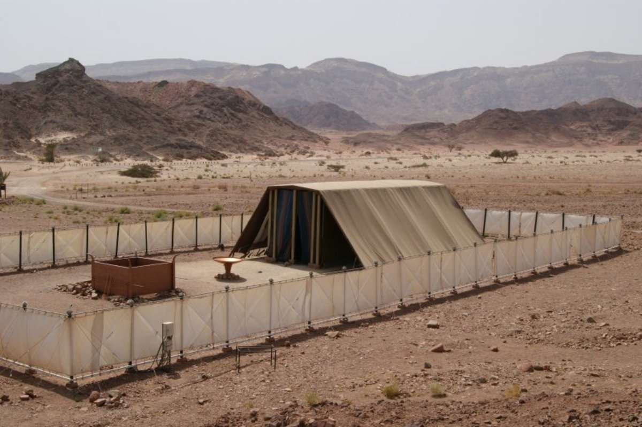
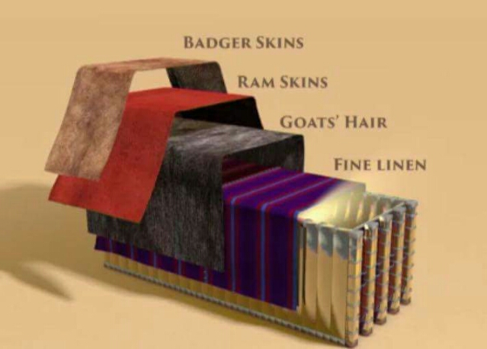
Exodus 26 v 1-14 – The Tabernacle coverings / roof
14And thou shalt make a covering for the tent of rams' skins dyed red, and a covering above of badgers' skins.

Slide 3
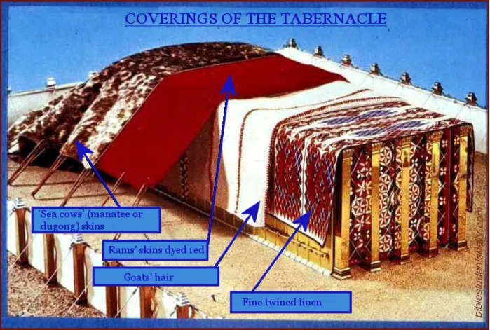
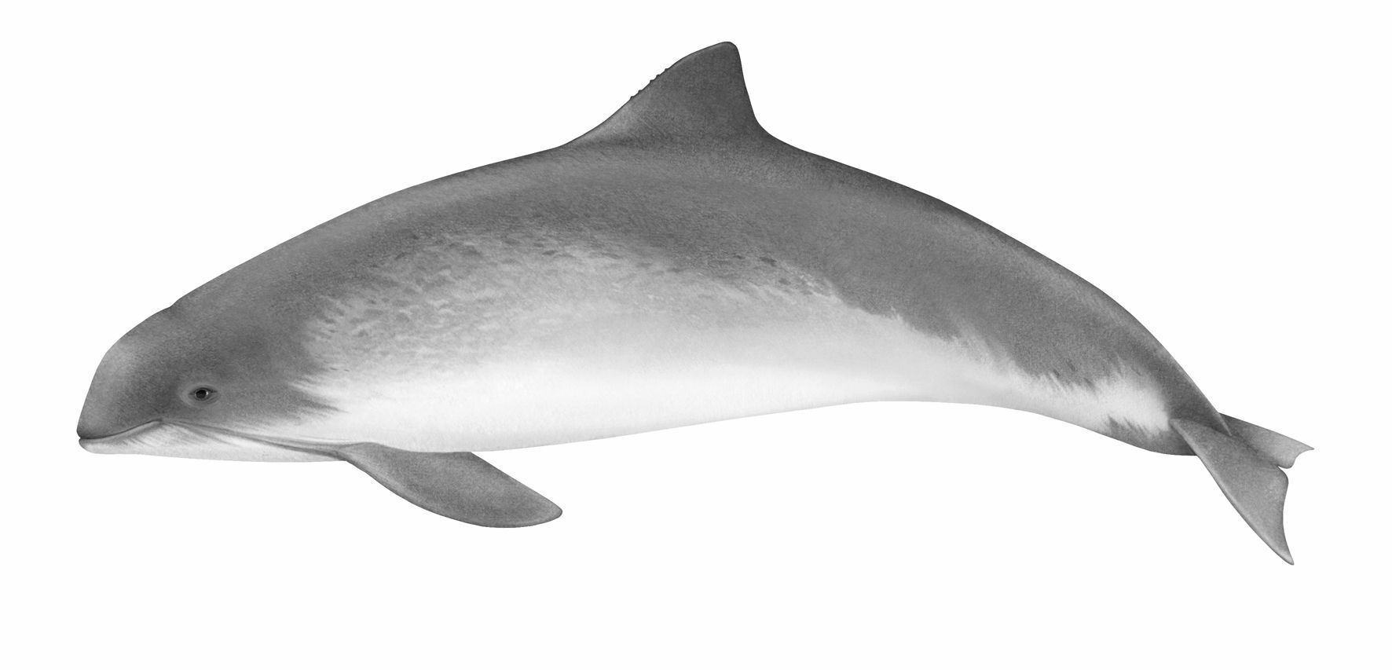
First / outer layer
= ‘badger skins’
or porpoise?

Slide 4
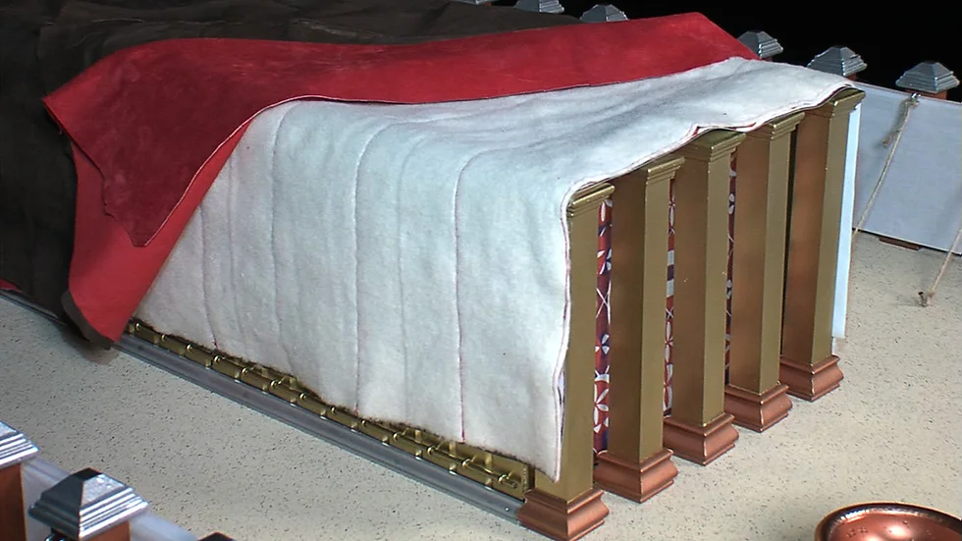
Goat’s hair layer = 11 curtains (6 curtains + 5 curtains)

Slide 5
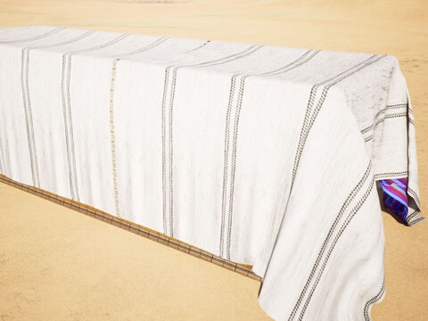
11 goat’s hair curtains One curtains = 30 x 4 ‘cubits’ (6 curtains + 5 curtains held with 50 brass clasps)
A ‘cubit’ is about 18 inches
Therefore, one curtain = approx 45ft x 6ft
30
cubits
45ft
X 50
4
cubits
6 ft
66 ft

Slide 6
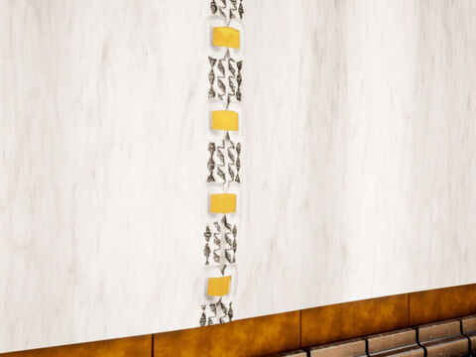
Curtains held together with 50 brass clasps

Slide 7
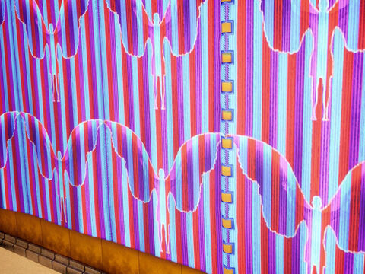
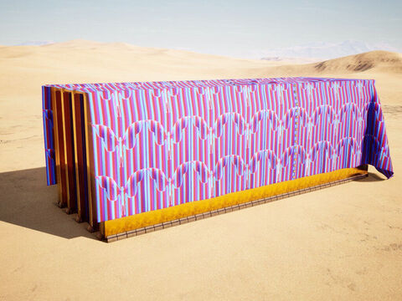
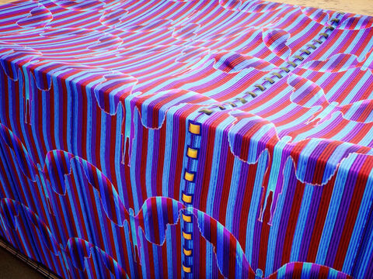
The embroidered fine linen inner layer 10 curtains = 5+5 curtains with gold clasps (One curtain = 28 x 4 ‘cubits’ / 42 x 6ft approx)

