Slide 1
‘At Midnight...’
1
Ruth Chapter 3 v8
‘At midnight, Boaz was startled and turned over,
and behold, a woman lay at his feet!’

Slide 2
2
Ruth Chapter 3v1-9
1One day Naomi said to Ruth, “My daughter, it’s time that I found a permanent home for you, so that you will be provided for. 2Boaz is a close relative of ours, and he’s been very kind by letting you gather grain with his young women. Tonight he will be winnowing barley at the threshing floor. 3Now do as I tell you—take a bath and put on perfume and dress in your nicest clothes. Then go to the threshing floor, but don’t let Boaz see you until he has finished eating and drinking. 4Be sure to notice where he lies down; then go and uncover his feet and lie down there. He will tell you what to do.”
5“I will do everything you say,” Ruth replied. 6So she went down to the threshing floor that night and followed the instructions of her mother-in-law.
7After Boaz had finished eating and drinking and was in good spirits, he lay down at the far end of the pile of grain and went to sleep. Then Ruth came quietly, uncovered his feet, and lay down. 8At midnight Boaz suddenly woke up and turned over. He was surprised to find a woman lying at his feet! 9“Who are you?” he asked.
“I am your servant Ruth,” she replied. “Spread the corner of your covering over me, for you are my family redeemer.” ( ie. Take me to be your wife and let your protection be upon me.’)

Slide 3
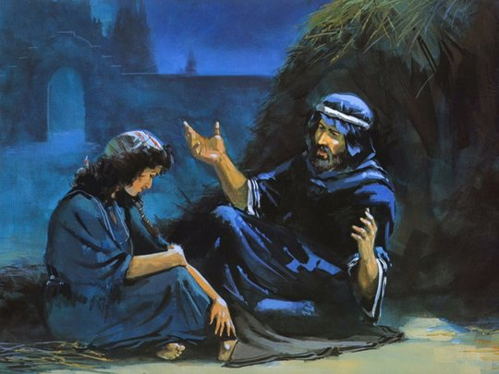
3
Ruth 3v8 – Boaz awakes at midnight and helps / gives justice and security for Ruth

Slide 4
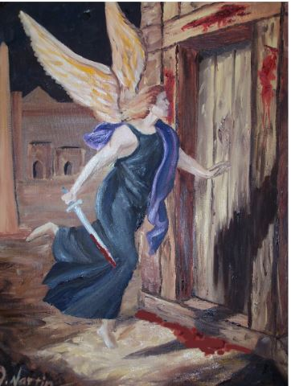
4
Exodus 11v4 and 12v29 – God arises at midnight, firstborn are killed,
and the Hebrews are saved and removed

Slide 5
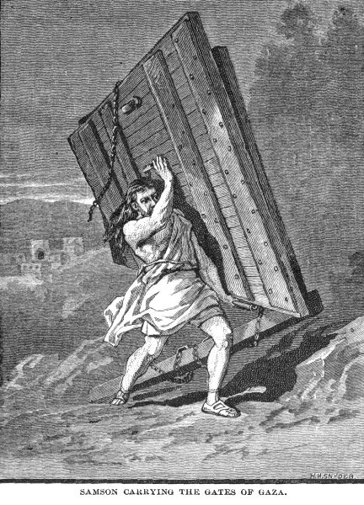
5
Judges 16v3 – ‘Samson…arose at midnight and took the doors of the gate of the city..’

Slide 6
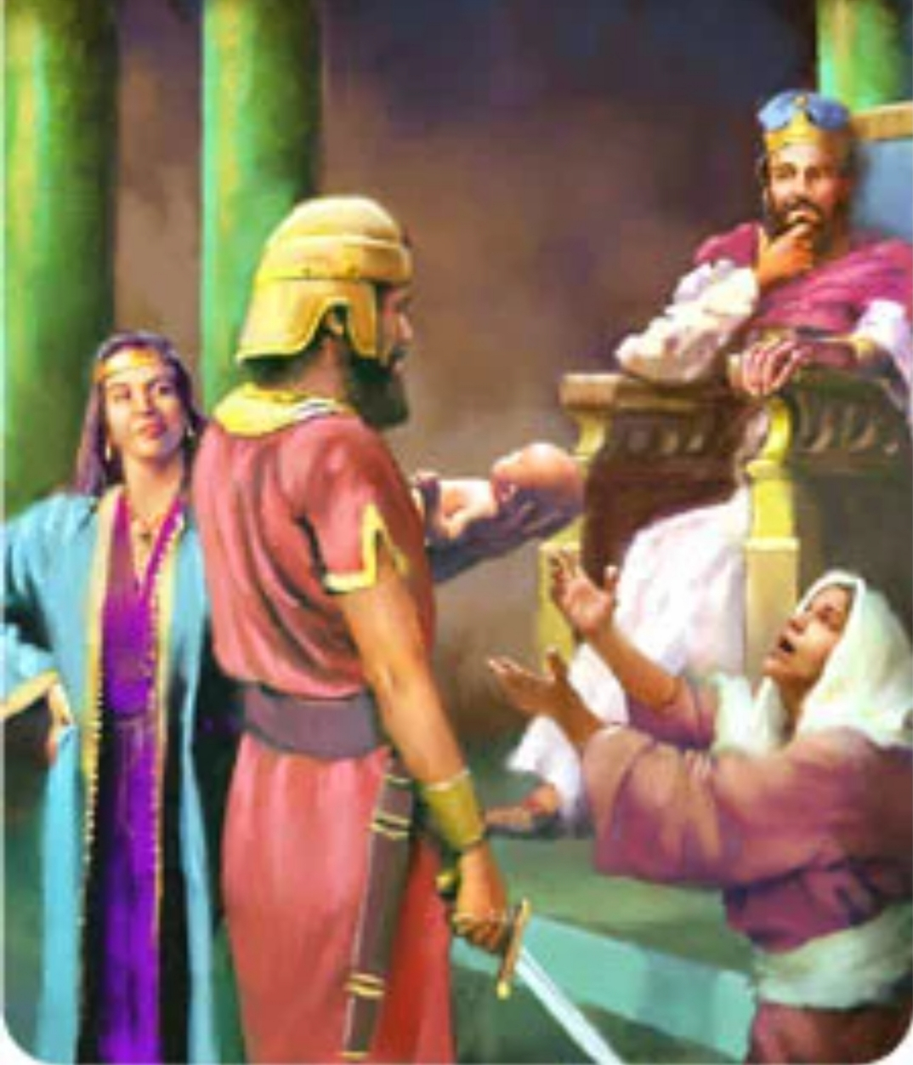
6
1 Kings 3v20 – ‘And she arose at midnight and took my living son..’

Slide 7
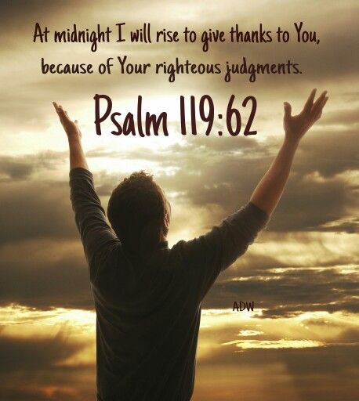
7
Psalms 119v62 - At midnight I will rise to give thanks unto thee because of thy righteous judgments.

Slide 8
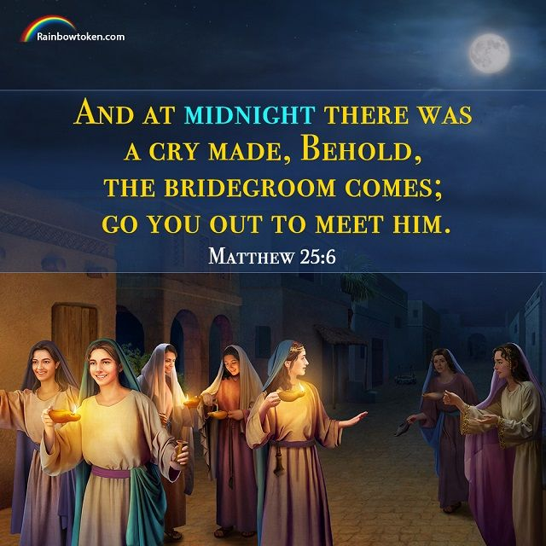
8

Slide 9
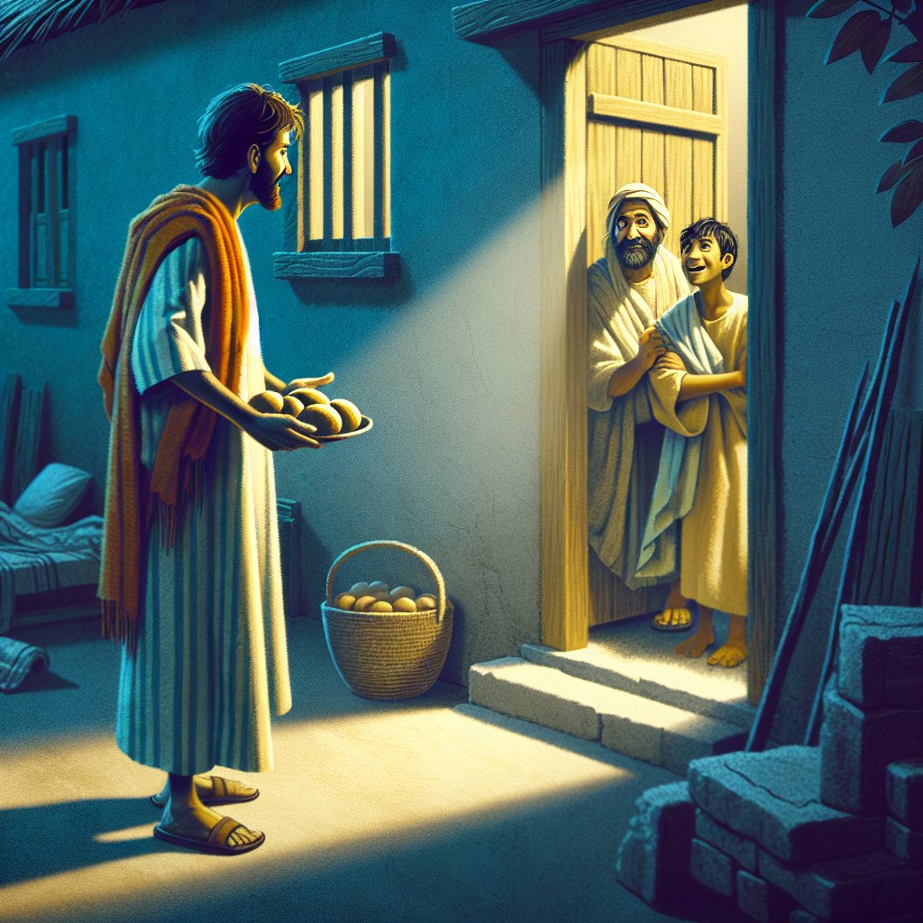
9
Luke 11v5 – ‘Which of you shall have a friend and shall go unto him at midnight..’

Slide 10
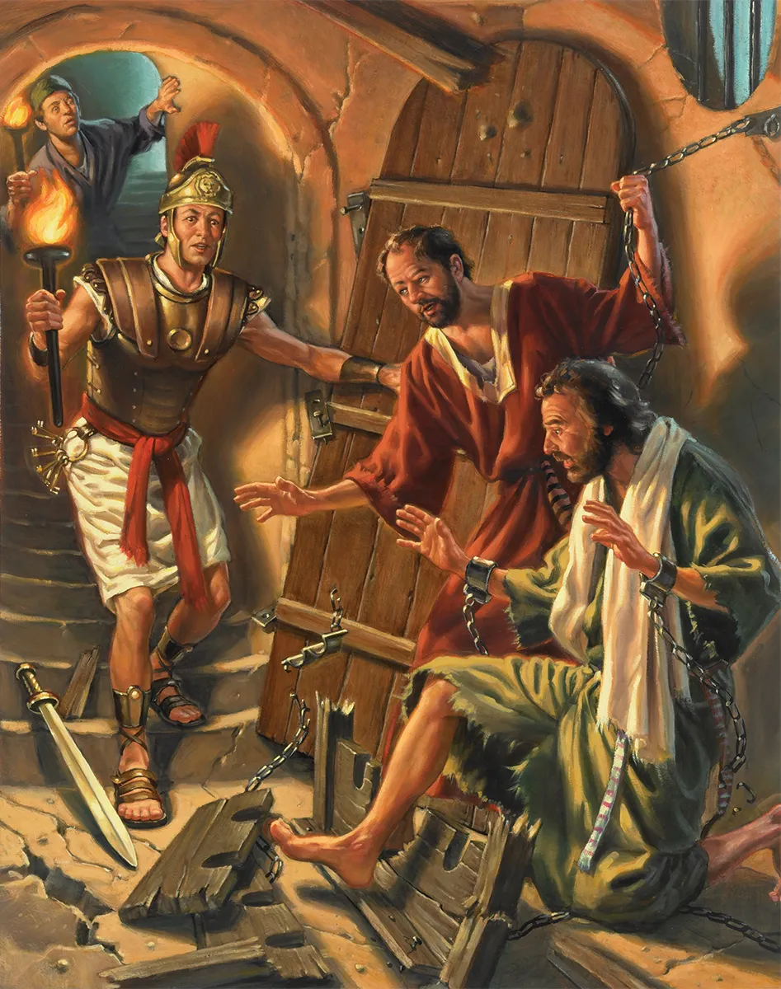
10
Luke 11v5 – ‘..a friend..at midnight..’
Acts 16v25 - ‘At midnight they sang praises..’

Slide 11
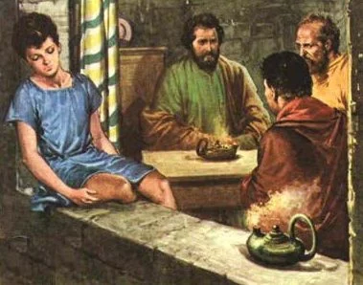
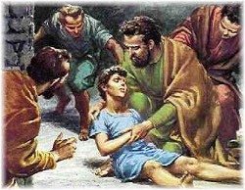
11
Acts 20v7 ‘Paul preached and continued his speech until midnight..
Having been overpowered by sleep,
Eutychus, fell down from the third story
and was picked up dead.
‘Don’t be alarmed,’ he said. ‘He’s alive!’

Slide 12
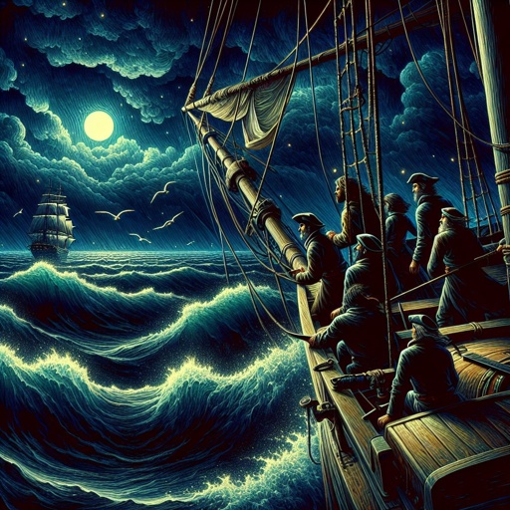
12
Acts 27v27
‘Now when the fourteenth night had come, as we were driven up and down in the Adriatic Sea, about midnight the sailors sensed that they were drawing near some country.’

Slide 13
13

Slide 14
14
Job 34:20
‘In a moment shall they die and the people shall be troubled at midnight and pass away:
and the mighty shall be taken away without hand.’
(New Living Translation: ‘They die in an instant, in the middle of the night;
the people are shaken and they pass away;
the mighty are removed without human hand.’)

